Slide 1
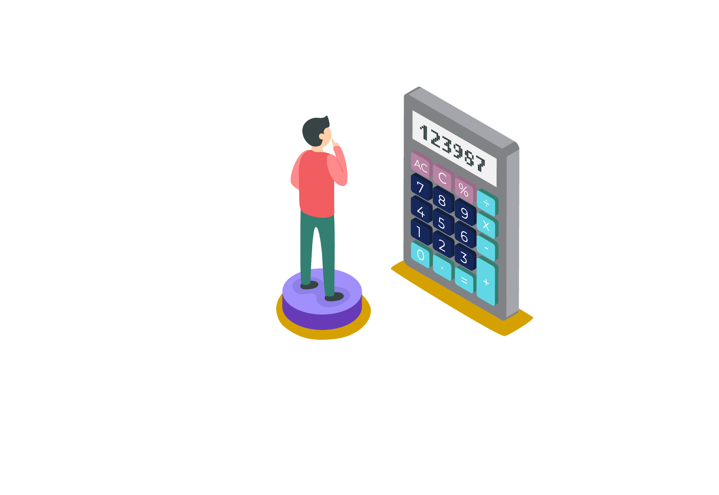

ABHAY MAHAJAN
B.Tech. IIT Roorkee
11+ years teaching experience
Mentored and taught around 20000+ students
Produced 400+ IIT selections
10+ INMO selections
1 EGMO Selection

Slide 2


Slide 3

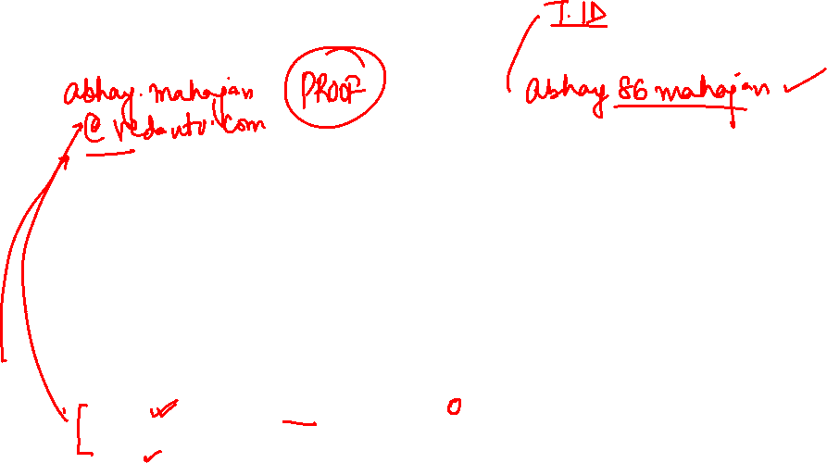

Slide 4


Slide 5
Chinese Remainder Theorem

Slide 6
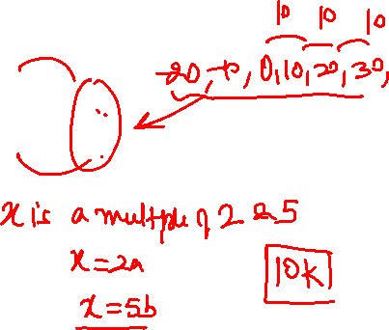
Let’s First try this example:
Ex: Find all x such that
x ≡ 0 (mod 2)
x ≡ 0 (mod 5)
Notes:
2020

Slide 7

Ex: Find all x such that
x ≡ 0 (mod 2)
x ≡ 0 (mod 5)
Solution
From the first congruence, we see that x is divisible by 2.
From the second, we see that x is also divisible by 5.
Thus x is divisible by 10, or
Notes:
2020

Slide 8
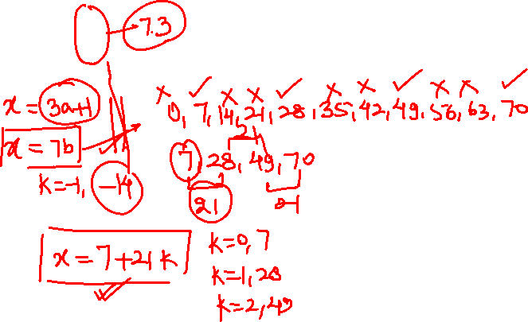
Now Let’s Consider this example:
Ex: Find all possible values of x that
x ≡ 1 (mod 3)
x ≡ 0 (mod 7)
Notes:
2020

Slide 9
Solution
From the second congruence, we see that x is divisible by 7.
We list first few non-negative multiples of 7. .
7, 14, 21, 28, 35, 42, 49, 56, 63, 70,....
We now list all integers in that have a remainder of 1 when divided by 3.
They are 7, 28, 49, 70,...
All these terms differ by lcm [3, 7], or 21
Thus x ≡ 7 (mod 21).
However, we are guessing this is the solution.
We write x ≡ 7 (mod 21) algebraically as
x = 21 y + 7
Notes:
2020

Slide 10
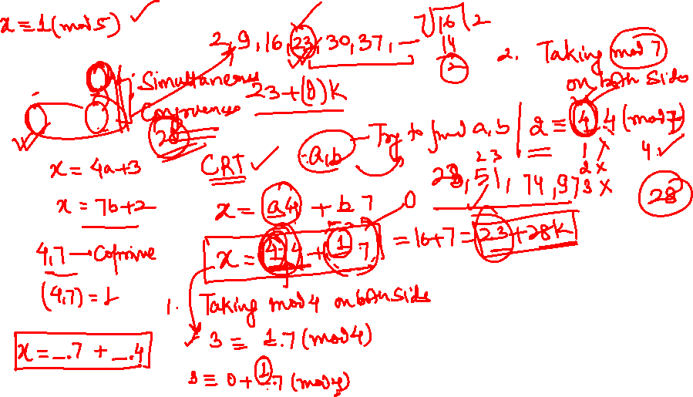
Q. Find all x such that
x ≡ 3 (mod 4)
x ≡ 2 (mod 7).
Notes:
2020

Slide 11
Solution
The first congruence tell us that x ≡ 3 (mod 4). We write this algebraically as
x = 4a + 3,
Where a is an integer.
The second congruence tells us that x ≡ 2 (mod 7). We write algebraically as
x = 7b + 2,
Where b is an integer,
Thus, we have to system of equations:
x = 4a + 3 = 7b + 2.
We rearrange the equation as 4a + 1 = 7b, and mod 7 to get
4a + 1 ≡ 0 (mod 7).
Notes:
2020

Slide 12
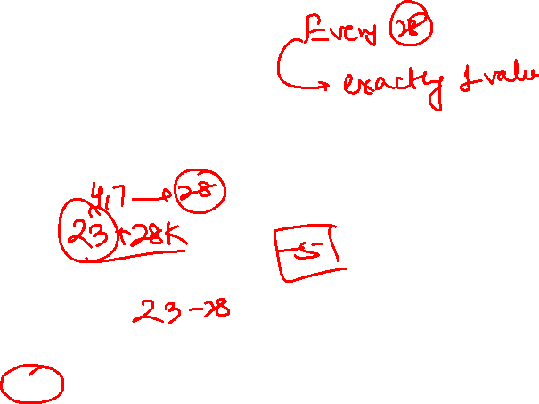
Solution
We subtract 1 from both sides of this congruence, and get
4a ≡ – 1 (mod 7) ⇒ 4a ≡ 6 (mod 7).
We multiply the congruence by the inverse of 4 (mod 7), which is 2. Thus, we have
4a ≡ – 6 (mod 7)
2 × 4a ≡ 2 × 6 (mod 7)
8a ≡ 12 (mod 7)
8a ≡ 5 (mod 7)
1 a ≡ 5 (mod 7)
a ≡ 5 (mod 7).
We substitute a = 5 into the equation
x = 4a + 3 = 7b + 2, and get x =23.
However this is not the only solution, because we expect the solution to be a congruence.
Notes:
2020

Slide 13


Solution
Since
23 ≡ 3 (mod 4)
23 ≡ 2 ( mod 7)
We subtract 23 from both sides of the congruences:
x – 23 ≡ 3 – 3 ≡ 0 (mod 4)
x – 23 ≡ 2 – 2 ≡ 0 (mod 7).
From this, we see that x –23 is divisible by both 4 and 7, which are relatively prime, so x –23 ≡ 0 (mod 28)
Thus, all values of x that satisfy the congruence are
Notes:
2020

Slide 14
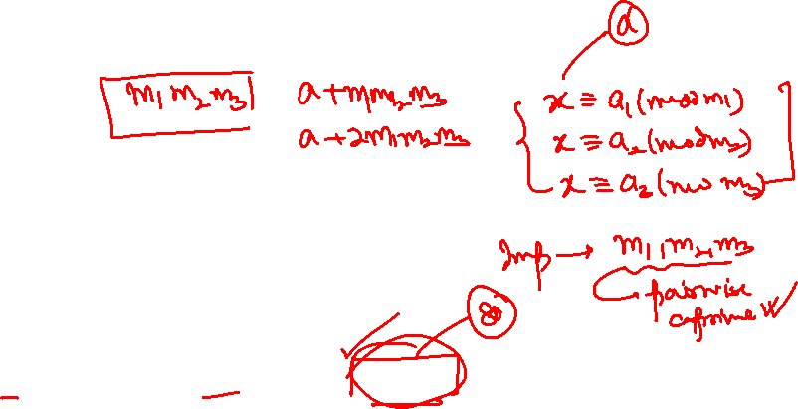
CHINESE REMAINDER THEOREM
Statement:
Let m₁, m₂, …., m_{r} denote r positive integers that are relatively prime in pairs, and let a₁, …, a_{r} denote any r integers. Then the congruences
x ≡ a_{i} (mod m_{i}), i = 1, …., r have common solutions.
Any two solutions are congruent modulo m₁m₂…m_{r}

Slide 15
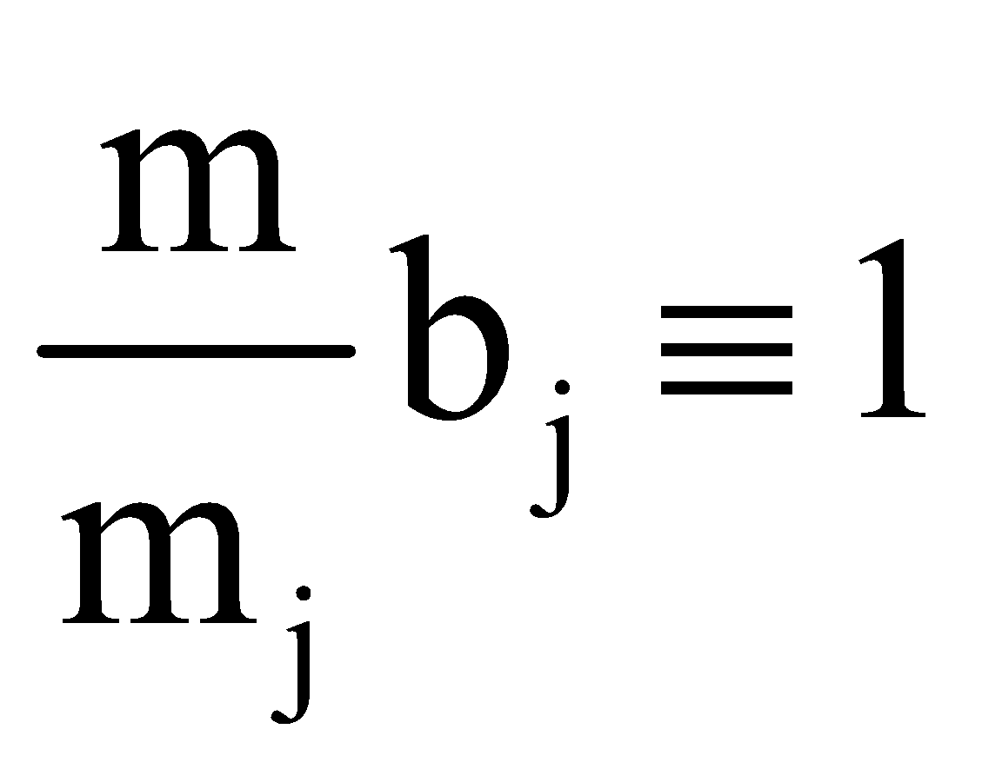
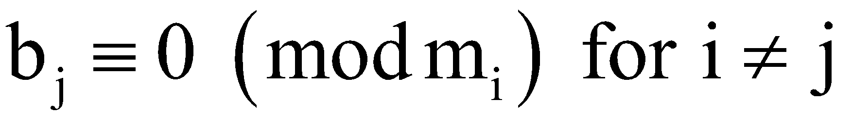
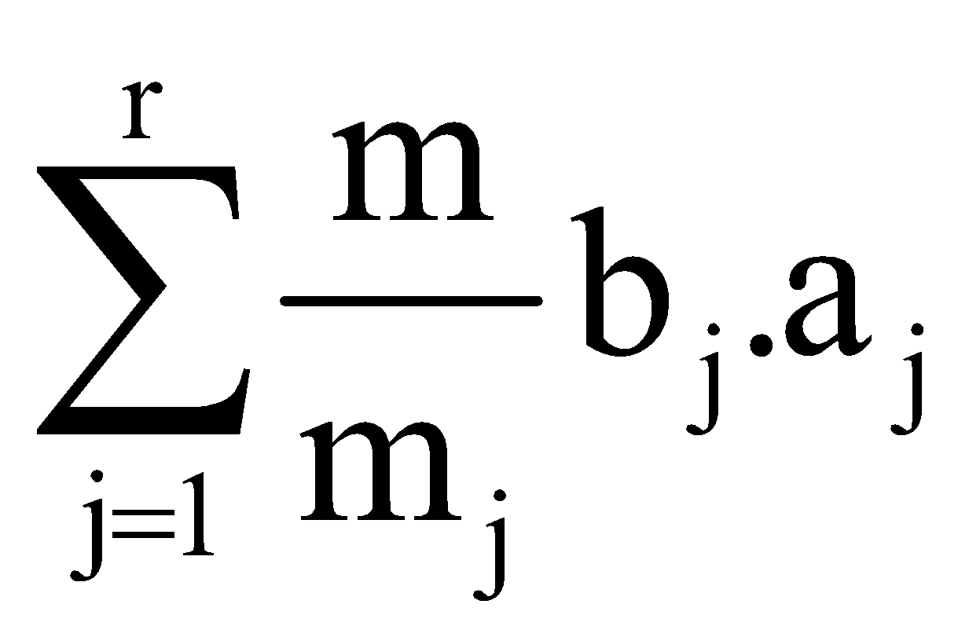
CHINESE REMAINDER THEOREM
Proof:
Let m = m₁m₂……m_{r}. Note that m/m_{j} and m_{j} are coprime. Hence, there exists b_{j} such that (m/m_{j}) b_{j} ≡ 1 (mod m_{j}). Clearly,
Define x₀= . Now, or 0 (mod m_{i})
according as j = i or j ≠ i. Hence x₀ is a solution of the system of congruences.
If x₀ and y₀ are solutions of the system, then x₀ – y₀ ≡ a_{i} – a_{i} ≡ 0(mod m_{i}) for each i. As m₁, ….. m_{r} are coprime in pairs, we get x₀ – y₀≡ 0 (mod m) as required.

Slide 16

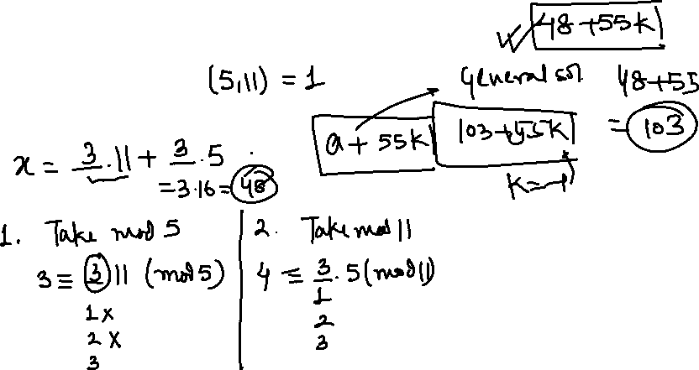
Q. Find the solution to the linear congruence
Notes:
2020

Slide 17

Solution
Notice that we may write x in the form
5k + 3 and 11m + 4
x = 5k + 3 = 11m + 4
Taking this equation mod 5 we arrive at
11m + 4 ≡ 3 (mod 5) ⇒ m ≡ – 1 (mod 5).
We substitute m = 5m₁ – 1 to give us
x = 11(5m₁–1) + 4 = 55m₁ –7.
Therefore ≡ 48 ( mod 55) which means
for some integer k.
Notes:
2020

Slide 18
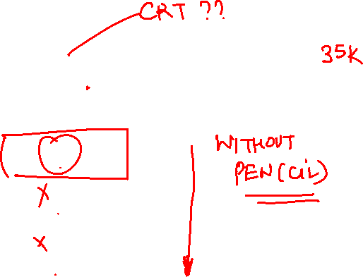
Q. The solutions of the system
x ≡ 4 (mod 5), x ≡ 6 (mod 7) are
A
34 + 35k , k ∈ Z
B
33 + 35 k, k ∈ Z
C
32 + 35k, k ∈ Z
D
None of these
Notes:
2020

Slide 19
Q. The solutions of the system
x ≡ 4 (mod 5), x ≡ 6 (mod 7) are
A
34 + 35k , k ∈ Z
B
33 + 35 k, k ∈ Z
C
32 + 35k, k ∈ Z
D
None of these
Notes:
2020

Slide 20
Q. The solutions of the system
x ≡ 4 (mod 5), x ≡ 6 (mod 7) are
Solution
Here m₁ = 5, m₂ = 7, M = m₁m₂ = 35,
M₁ = M/m₁ = 7, M₂ = M/m₂ = 5
M₁≡ 2 (mod 5), hence, M₁’ ≡ 3 (mod 5)
M₂ ≡ 5(mod 7), hence M₂’ ≡ 3 (mod 7)
∴ x_{o} = 4M₁M₁’ + 6M₂M₂’
= 4 × 7 × 3 + 6 × 5 × 3 = 174 ≡ 34 ( mod 35)
⇒ x₀ = 34 + 35K, k ∈ Z
Notes:
2020

Slide 21
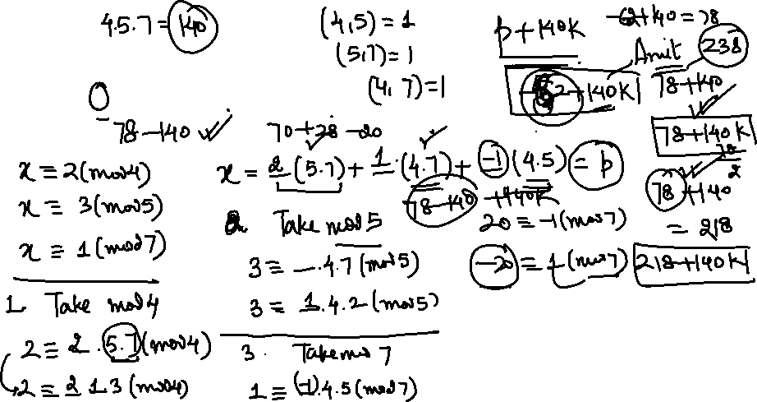
Q. Find all solutions of the system
x ≡ 2 (mod 4), x ≡ 3 (mod 5), x ≡ 1 (mod 7).
Notes:
2020

Slide 22
Solution
Here m₁ = 4, m₂ = 5, m₃ = 7, M = m₁m₂m₃
= 140, M₁ = M/m₁ = 35, M₂ = M/m₂ = 28, M₃ = M/m₃ = 20
M₁ ≡ 3 (mod 4), hence, M₁’ ≡ 3 (mod 4)
M₂ ≡ 3 (mod 5), hence M₂’ ≡ 2 (mod 5)
M₃ ≡ 6 (mod 7), hence M₃’ ≡ 6 (mod 7)
∴ x_{o} = 2M₁M’₁ + 3M₂ M’₂ + 1 M₃M’₃
2 × 35 × 3 + 3 × 28 × 2 + 20 × 6 = 498
≡ 78 (mod 140)
Notes:
2020

Slide 23
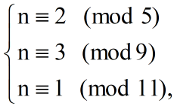
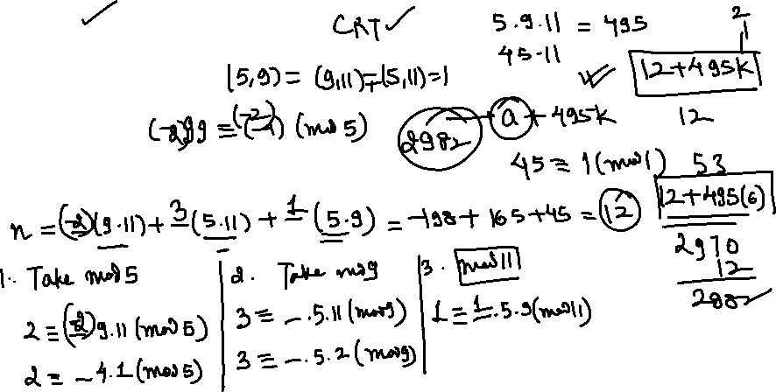
Q. If a positive integer n satisfies
What is the 7th smallest possible value of n?
Notes:
2020

Slide 24
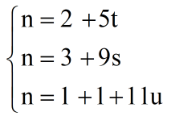
Solution
We can translate these congruences into equations for some integers t, s and u:
By substituting the n from the first equation into the second congruence, we have
2 + 5t ≡ 3 (mmod 9)
5t ≡ 1 (mod 9)
t ≡ (5)^{–1} ≡ 2 (mod 9)
meaning that t = 2 + 9x for some integer x.
By substituting t into the first equation, we have
Notes:
2020

Slide 25
Solution
12 + 45x ≡ 3 (mod 11)
1 + 45 x ≡ 1 (mod 11)
x ≡ 0 (mod 11)
meaning that x = 0 + 11y for some integer y.
By substituting x into (1), we have
n = 12 + 45 x = 12 + 45 (11y) = 12 + 495 y.
Therefore, the sequence of n is 12, 507, 1002,...,
Which is an arithmetic progression.
Hence the 7th term is
12 + 495 × (7 – 1) = 2982.
Notes:
2020

Slide 26
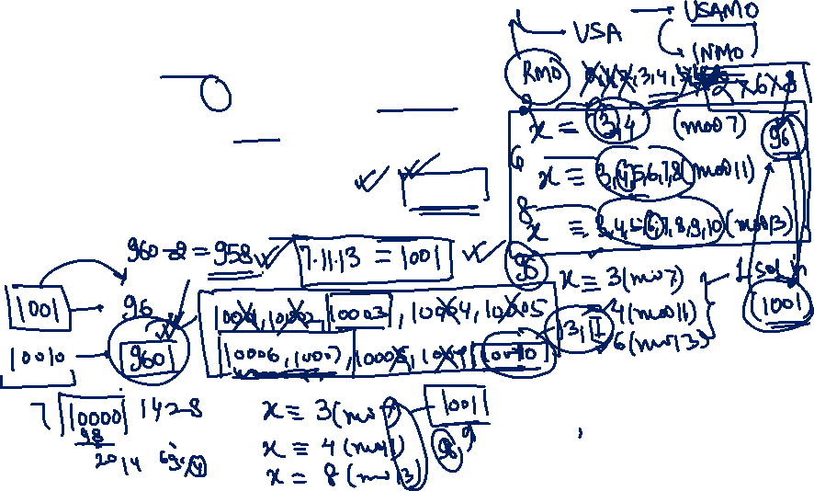
Q. For a positive integer p, define the positive integer n to be p-safe if n differs in absolute value by more than 2 from all multiples of p. For example, the set of 10-safe numbers is 3, 4, 5, 6,7, 13, 14, 15, 16, 17, 23,... Find the number of positive integers less than or equal to 10, 000 which are simultaneously 7 -safe , 11-safe and 13-safe
AIME II 2012
Notes:
2020

Slide 27
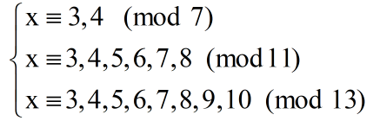
Solution
We notice that if x is 7-safe, and 13-safe then we must have
By Chinese Remainder Solution this renders solution mod. 1001
We have 2 choice for the value of x mod 7, 6 choices for the value of x mod 11 and 8 choice for the value of x mod 13.
Therefore, we have 2.6.8 = 96 total solution mod 1001.
We consider the number of solutions in the set

Slide 28
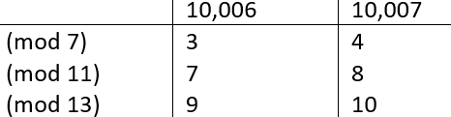
Solution
{1, 2 …, 1001}, {1002,....2002}, {2003,...3003},....{9009,...10010}.
From above there are 96.10 total solution. However we must subtract the solution in the set
{10, 001; 10, 002;... 10, 010}.
We notice that only x = 10,006 and
x = 10,007 satisfy x ≡ 3, 4 (mod 7).

Slide 29

Solution
These values are arrived from noting that
10,006 ≡ –4 (mod 7. 11. 13) and
10, 007 ≡ – 3(mod 7. 11. 13).
Therefore x = 10, 006 and x = 10,007 are the two values we must subtract off.
In conclusion we have 960 –2 =

Slide 30
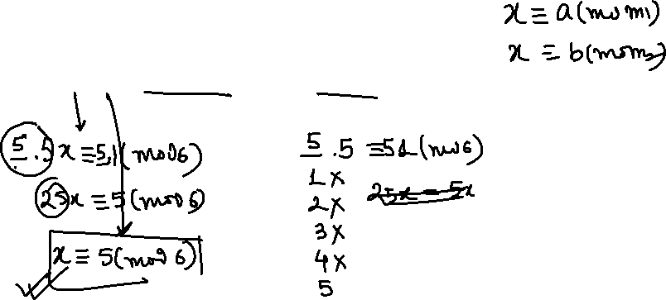
Q. Solve the system of linear congruences
5x ≡ 1 (mod 6), 3x ≡ 2 (mod 5) and 4x ≡ 5 (mod 7)
H.W. Question
Write Your Answer in the comment
Notes:
2020

Slide 31
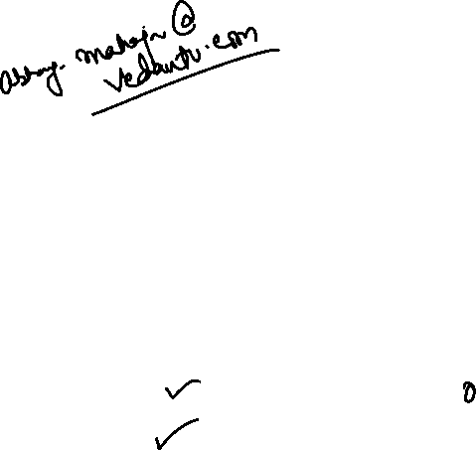

Slide 34




Let’s Bring
GOLD
For
INDIA

